Slide 1
Memory Introduction

Slide 2
Introduction
Consider a simple analogy that illustrates the key principles and mechanisms.
Principle of locality underlies both the way in which you did your work in the library and the way that programs operate.
The principle of locality states that programs access a relatively small portion of their address space at any instant of time.

Slide 3
Contd.,
There are two different types of locality:
Temporal locality: The principle stating that if a data location is referenced then it will tend to be referenced again soon. Ex: Loops
Spatial locality: The locality principle stating that if a data location is referenced, data locations with nearby addresses will tend to be referenced soon. Ex: Arrays

Slide 4
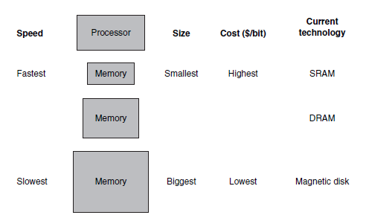
Basic Structure of Memory Hierarchy

Slide 5
Contd.,
SRAM: Static random access memory
Data is stored in transistors and require constant power flow
DRAM: Dynamic random access memory
Data is stored in capacitors.
A memory hierarchy consists of multiple levels of memory with different speeds and sizes.

Slide 6
Contd.,
The faster memories are more expensive per bit than the slower memories and thus are smaller.
Faster memory is close to the processor and the slower, less expensive memory is below it.
Memory hierarchy A structure that uses multiple levels of memories; as the distance from the processor increases, the size of the memories and the access time both increase.

Slide 7
Contd.,
The goal is to present the user with as much memory as is available in the cheapest technology, while providing access at the speed offered by the fastest memory.
As we move away from the processor, the levels take progressively longer to access.
A memory hierarchy can consist of multiple levels, but data is copied between only two adjacent levels at a time, so we can focus our attention on just two levels.

Slide 8
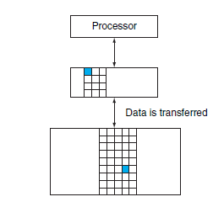
Contd.,
Every pair of levels in the memory hierarchy can be thought of as having an upper and lower level.

Slide 9
Definitions
The minimum unit of information that can be either present or not present in the two-level hierarchy is called a block or a line.
If the data requested by the processor appears in some block in the upper level, this is called a hit.
If the data is not found in the upper level, the request is called a miss.
The lower level in the hierarchy is then accessed to retrieve the block containing the requested data.

Slide 10
Definitions Contd.,
The fraction of memory accesses found in a level of the memory hierarchy is termed as hit rate.
Used to measure of the performance of the memory hierarchy.
The fraction of memory accesses not found in a level of the memory hierarchy is termed as miss rate.
Hit time The time required to access a level of the memory hierarchy, including the time needed to determine whether the access is a hit or a miss.

Slide 11
Definitions Contd.,
Miss penalty is the time to replace a block in the upper level with the corresponding block from the lower level, plus the time to deliver this block to the processor.
Memory systems are critical to performance.
All programs spend much of their time accessing memory.
Memory system is necessarily a major factor in determining performance.

Slide 12
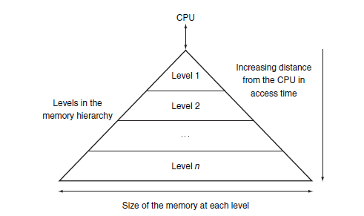
Important Observations
Memory hierarchies take advantage of temporal locality.
keeping more recently accessed data items closer to the processor.
Memory hierarchies take advantage of spatial locality.
moving blocks consisting of multiple contiguous words in memory to upper levels of the hierarchy.

Slide 13
Memory Technologies
There are four primary technologies used today in memory hierarchies.
1. SRAM Technology
Static random access memory
Closer to the processor (caches)
SRAMs are simply integrated circuits that
are memory arrays with (usually) a single
access port that can provide either a read
or a write.
No need to refresh.

Slide 14
Memory Technologies Contd.,
2. DRAM Technology
Dynamic random access memory.
Main memory is implemented from DRAM.
DRAM is less costly per bit than SRAM, and substantially slower.
Value kept in a cell is stored as a charge in a capacitor.
Periodic refresh.
3. Flash Memory
Flash memory is a type of electrically erasable programmable read-only memory (EEPROM).
This nonvolatile memory is the secondary memory in Personal Mobile Devices.

Slide 15
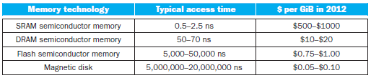
Memory Technologies Contd.,
4. Disk Memory
Largest and slowest level in the hierarchy in servers.
A magnetic hard disk consists of a collection of platters.
The metal platters are covered with magnetic recording material on both sides, similar to the material found on a cassette or videotape.
Disk surface, tracks, sectors.

